Slide 2
Accelerated Engineering using templates and provisioning
Kevin Mamajek
Sales Engineer – IoT software
TRIDIUM, Inc.

Slide 3
Objectives
Dependency: Niagara 4.6
You will be able to:
Hold Questions for the end
Define a what a template
Prepare for a template
Use Workbench template tools
Creating a template
Look into a template file
Demo: Creating, Deploying, Updating a template
Demo: Create a device template
Demo: Deploying a device template, updating it with sub-templates
Bulk deploying templates
Demo: Bulk deploying with an excel file

Slide 4
What is a template?
A deployable package of Niagara objects
Components are contained in a file with the extension of .ntpl /
zip in disguise
Can be grouped into modules for easy distribution
Deployed configurations extend the installation process used for a single component, at deployment you make the finishing touches.

Slide 5
The Setup
Plan ahead / Pre-work
Utilize the Tag Dictionary
Layout the points and tag them
Build and test all screens together
Build Master templates first
Then remove items you may want to be subs
Test, Test, Test, and Deploy

Slide 6
Pre-work
Planning for what the template will do and how it will do it

Slide 7
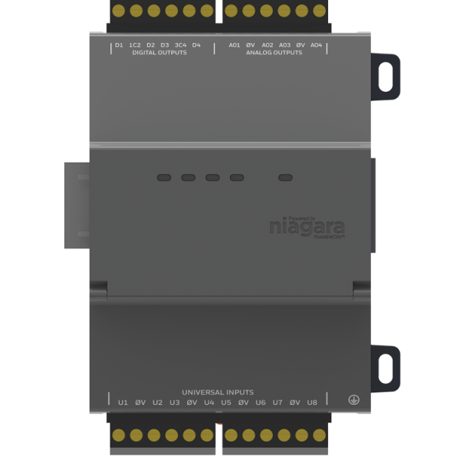
What are you going to template: NRIO 16

Slide 8
The Process
Points
Tags
Relations
Logic / Screens

Slide 9
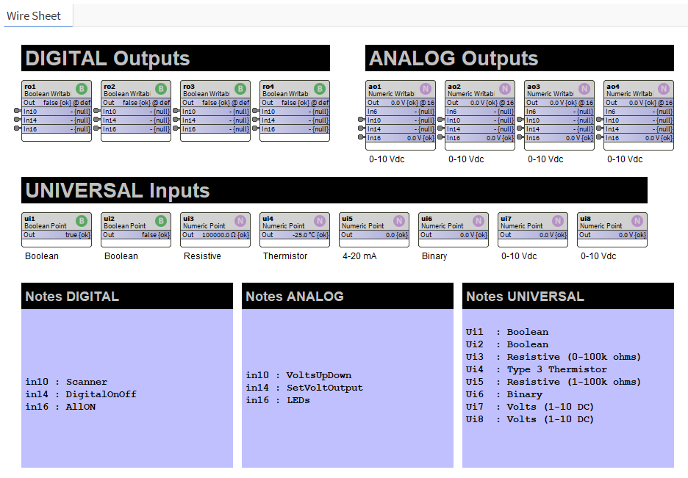
Point layout
Layout Points in a meaningful manner
Use notes to remind you where the connections come from

Slide 10
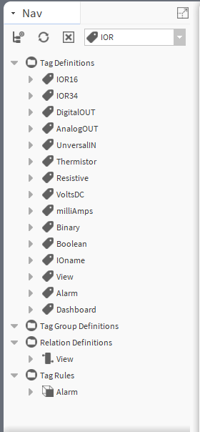
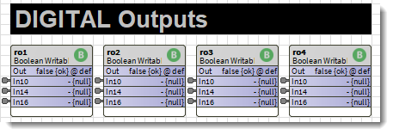
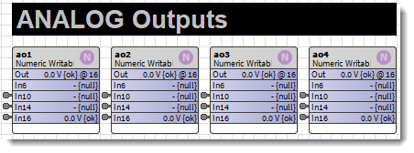
Tagging
Tags
ro1 – ro4
DigitalOUT
Tags
ao1 – ao4
AnalogOUT
VoltsDC
Tags
ui1 – ui8
UniversalIN
Boolean
Resistive
Thermistor
Binary
VoltsDC
Boolean
Thermistor
VoltsDC
Resistive
Binary

Slide 11
Consider Tagging alarms
Tags
IOR16
IOR34
Implied Tags
Alarm

Slide 12
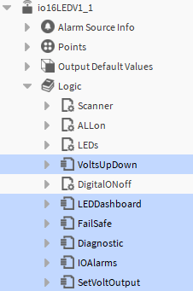
Tagging Views
Px Page
io16LEDV1_1
VoltsUpDown
DigitalONoff
FailSafe
Diagnostic
IOAlarms
SetVoltOutput
Tags
View
Tags
View
Dashboard
Px Page
LEDDashboard

Slide 13
Setting Relations back to device
Px Page
VoltsUpDown
DigitalONoff
FailSafe
Diagnostic
IOAlarms
SetVoltOutput
LEDDashboard
Relation
io16LEDV1_1

Slide 14
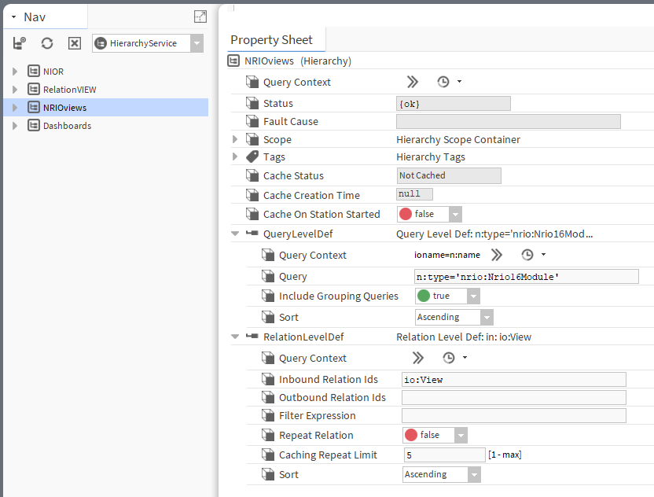
Hierarchy

Slide 15
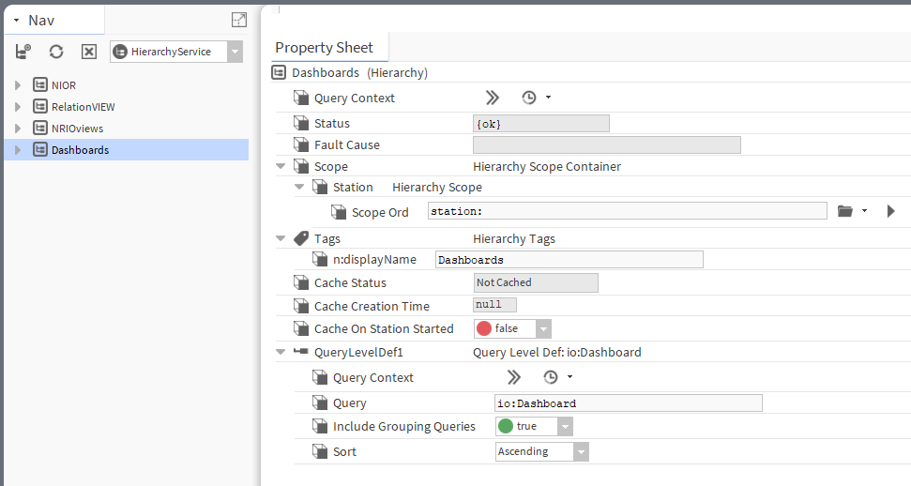
Hierarchy

Slide 16
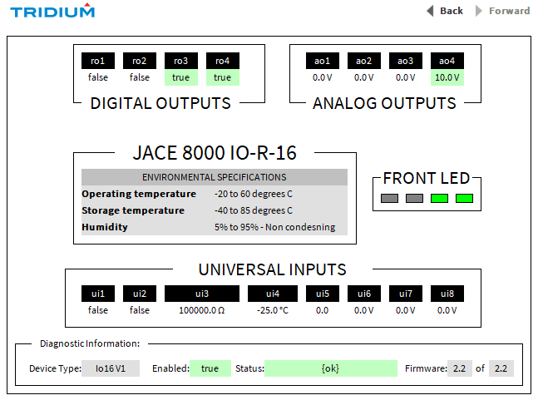
Screen layout
Diagnostic Screen
Layout all screens

Slide 17
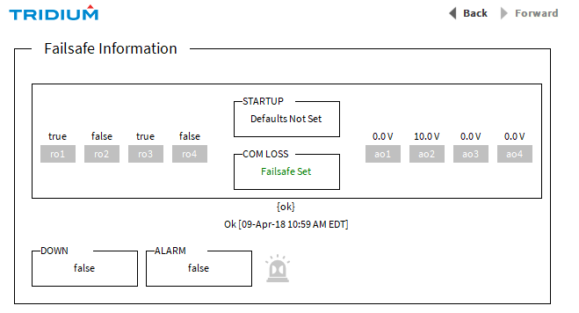
Screen layout
Layout all screens

Slide 18
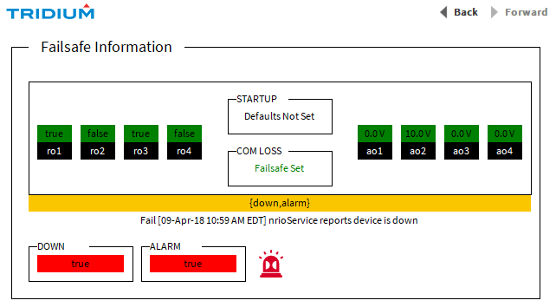
Screen layout
Failsafe Screen
Layout all screens

Slide 19
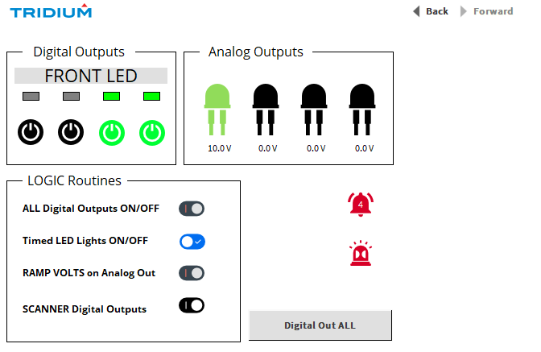
Dashboard layout
Layout all screens

Slide 20
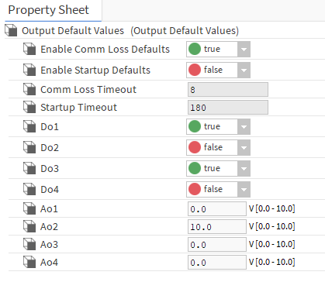
Default Settings
Set any defaults

Slide 21
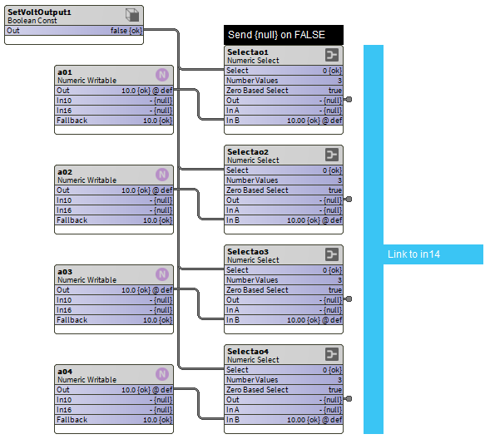
Logic layout
Logic

Slide 22
Template tools
Services, Pallet, Sidebar, Right-Click Make, DevTemplate mode

Slide 23
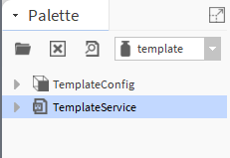
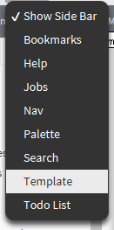
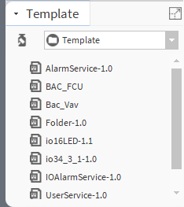
Template Tools
Palette
Side Bar Template
Software Manager

Slide 24
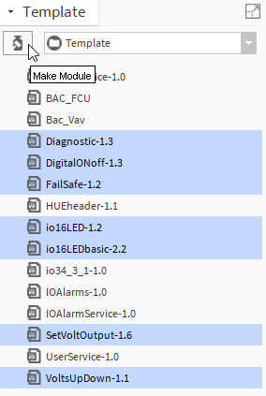
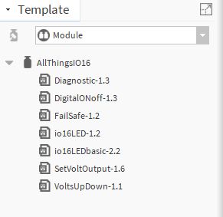
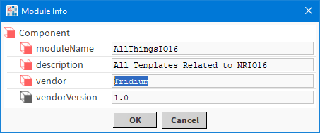
Template Tools
Read-only versions

Slide 25
Template types
Station
The entire station is templated.
During commissioning of a new station, you can choose the template to apply
Device
A device template, during commissioning of a new device you can apply a template.
Component
Any component, that you can then drag-and-drop to apply

Slide 26
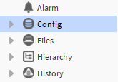
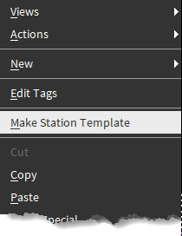
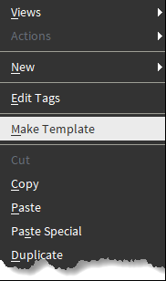
Station Template vs Templates
Right-Click
Right-Click
Station ONLY
Individual Templates
Only the Config top level
Anything under the config space

Slide 27
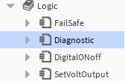
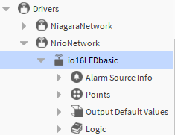
Device vs Component Templates
Right-Click
Right-Click
Device Template
Component Template
Component
Device top level

Slide 28
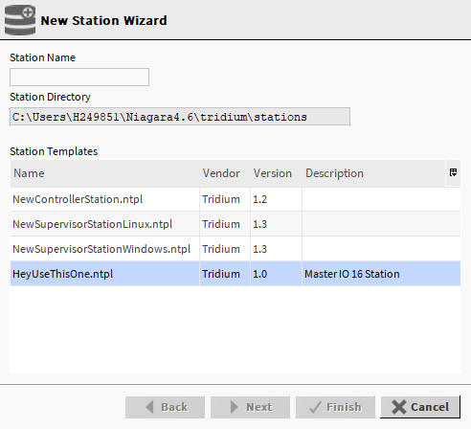
Applying station templates

Slide 29
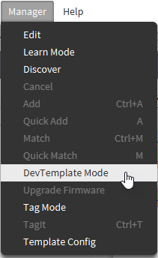
Device template mode
DevTemplate Mode

Slide 30
Device template mode

Slide 31
Station template service

Slide 32
Creating templates
SetVoltOutput template that will eventually be used as a sub-template

Slide 33
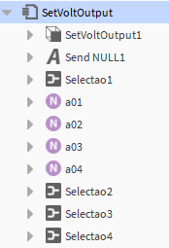
SetVoltOutput Template
Tags
View
Relation
io16LEDV1_1
Px View
Internal Points

Slide 34
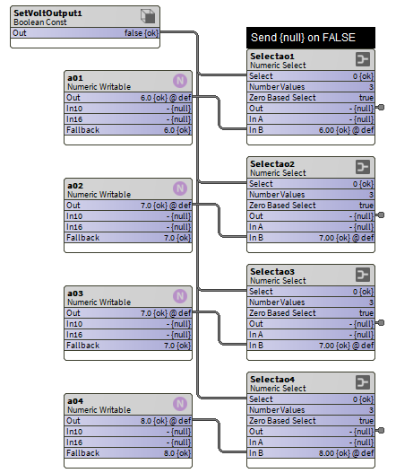
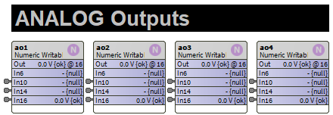
SetVoltOutput Template
Tags
ao1 – ao4
AnalogOUT
VoltsDC
External Tagged Points
Internal Logic

Slide 35
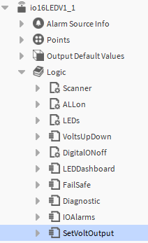
SetVoltOutput Template
Right-Click

Slide 36
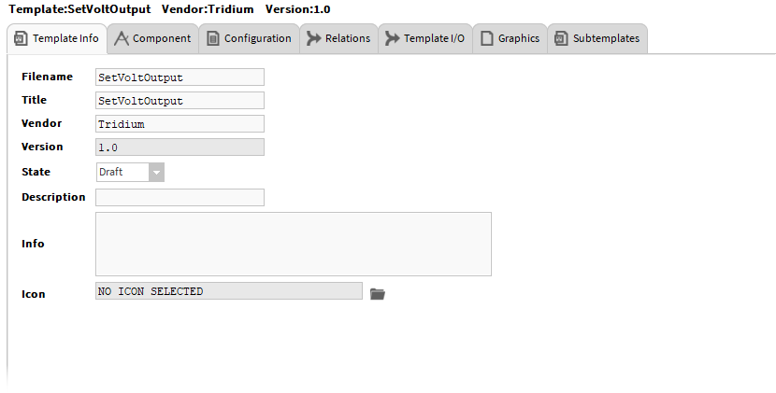
Basic template information
State – Draft/Ready
Version control for deploying templates

Slide 37
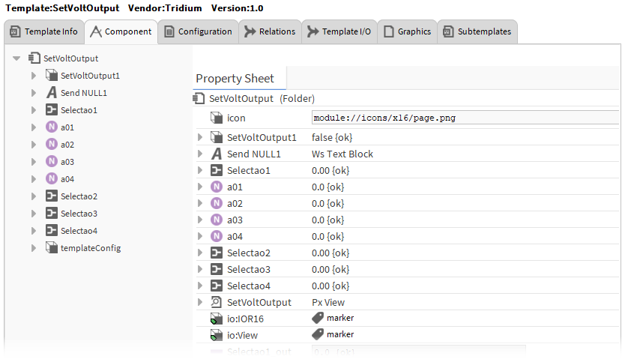
All Components that are included in the template, including the template information (templateConfig)

Slide 38
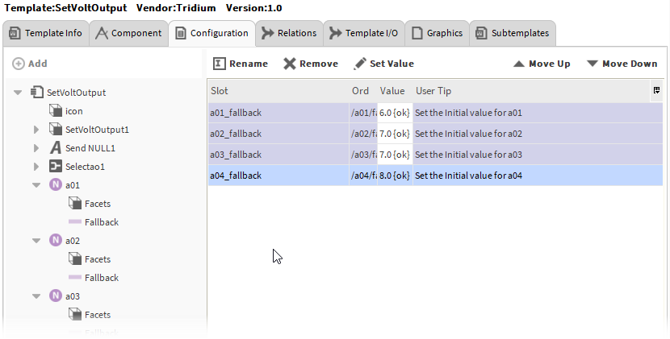
Configuration TAB allows the template to prompt for these values during the deployment process

Slide 39
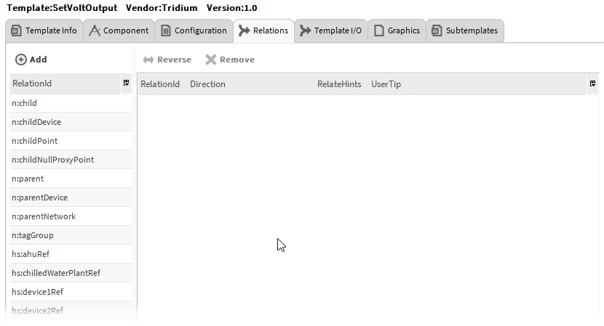
Relations TAB allows the template to prompt for these values during the deployment process

Slide 40
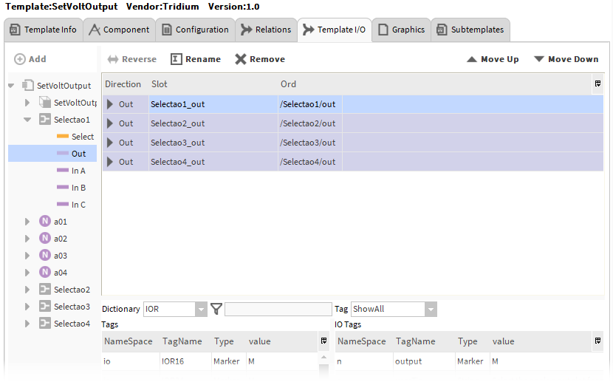
This tab allows for you to create hints and searches to help the user connect internal points within the template to external points at deployment
We will look at this in more detail on the next slide

Slide 41
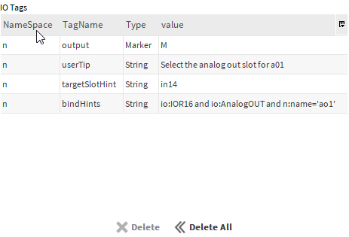
The Template IO Tab (IO Tags)
Link any IO points that reference any External points
userTip
“Select the in slot 14 of the analog out 1 (ao1) point
targetSlotHint
in14
bindHints
io:IOR16 and io:AnalogOUT and n:name='ao1'
Tags CAN HELP
Tags
ao1
AnalogOUT

Slide 42
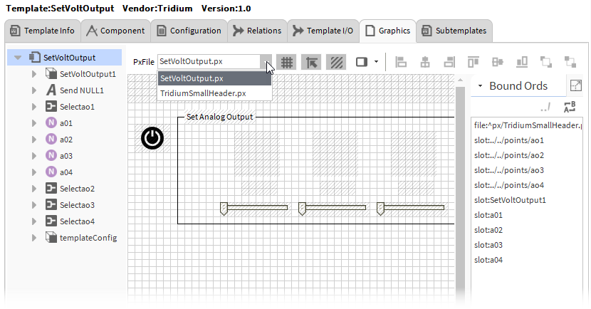
The graphics tab includes all the PX pages within the template

Slide 43
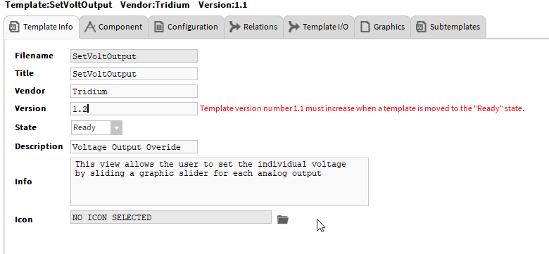
Saving Template (Draft / Ready)

Slide 44
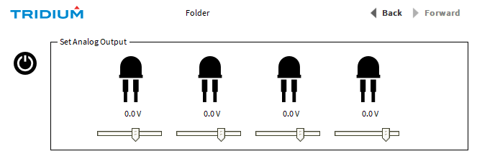
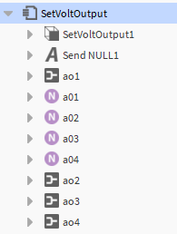
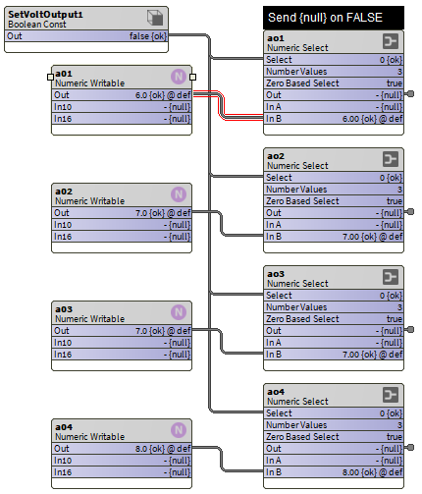
SetVoltOutput Template
Components
External I/O
On Deployment Assignment

Slide 45
Deep dive: Template files
For when you really need to know

Slide 46
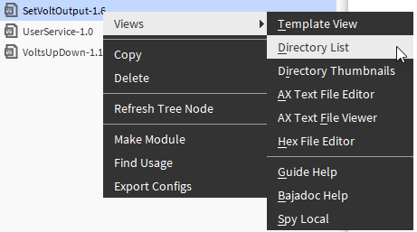
Directory List

Slide 47
SetVoltOutput Template file contents
Users > Me > Niagara4.6 > templates

Slide 48
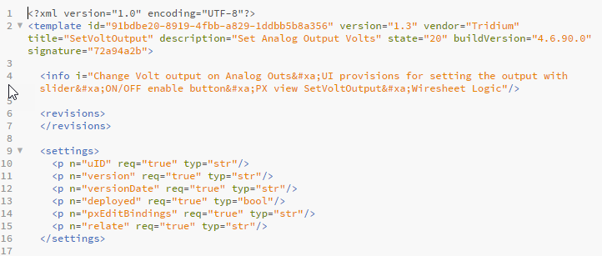
SetVoltOutput Template file contents

Slide 49
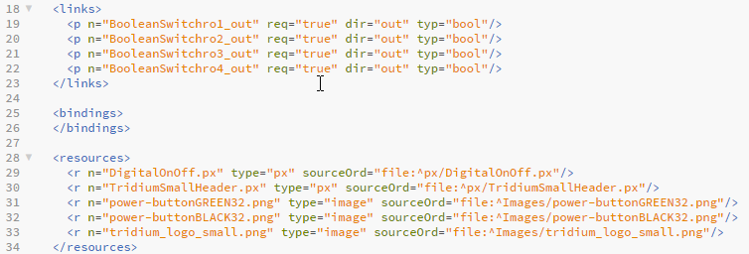
SetVoltOutput Template file contents

Slide 50
SetVoltOutput Template file contents

Slide 51
SetVoltOutput Template file contents

Slide 52
Demo

Slide 53
.6
demonstration
Creating The SetVoltOutput Template

Slide 54
.6
demonstration
Deploying SetVoltOutput with drag-and-drop
Template Service
Deployment files

Slide 55
.6
demonstration
Creating a device template

Slide 56
.6
demonstration
Deploying Basic then adding
2 Sub-templates
Updating deployment

Slide 57
Deploying a device template

Slide 58
But wait, there’s more
If you act now, we will include bulk for FREE

Slide 59
Deep dive: Bulk Deploying Templates
Now the fun begins

Slide 60
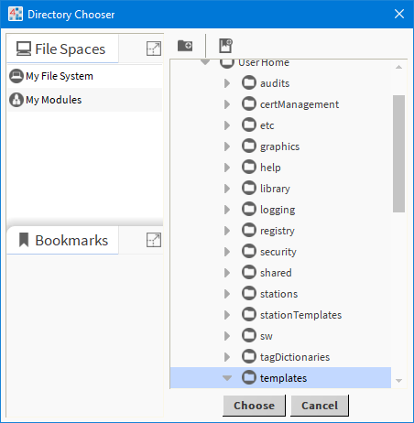
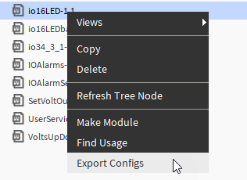
Bulk deploy

Slide 61
Bulk deploy

Slide 62
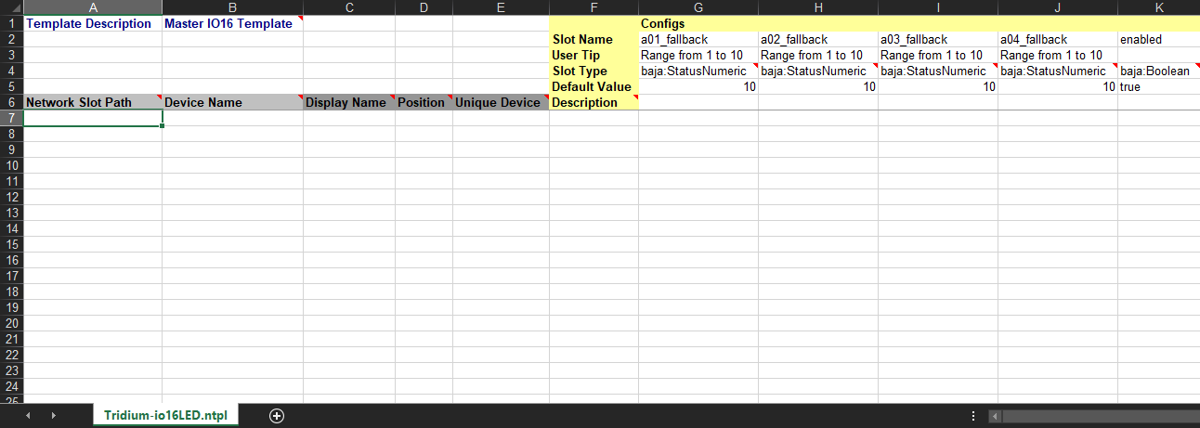
Template Configuration excel file

Slide 63
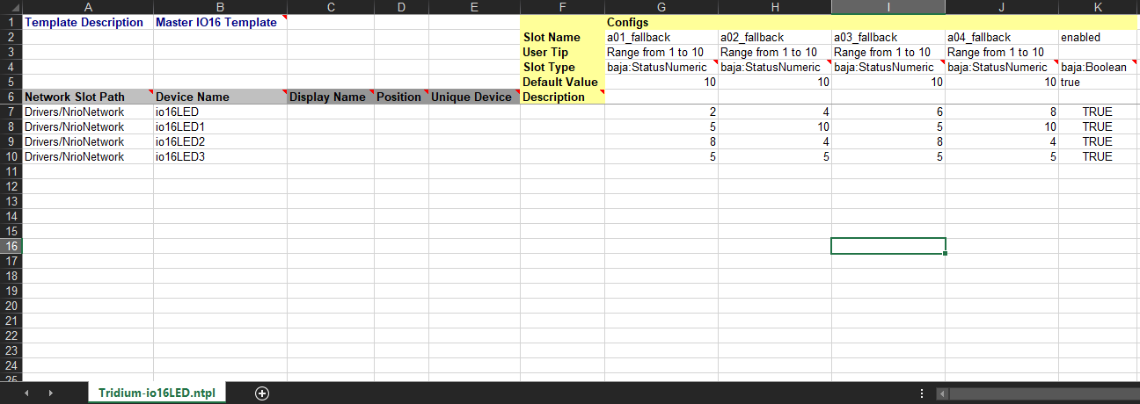
Values of the Config Tab for each device

Slide 64
Bulk Deploy from Excel
From the TemplateService

Slide 65
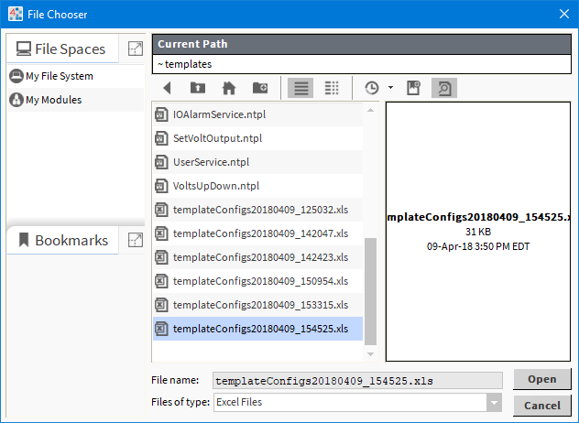
Select template Config file

Slide 66
Select template Config file

Slide 67
.6
demonstration
Export Config
Update Excel Sheet
Bulk deploy from Excel

Slide 68
What’s Next

Slide 69
What’s next
Templates and provisioning
Determining if a template is being used as a sub-template
The value proposition: templates / provisioning / system db

Slide 70
Resources
Workbench Help
This Presentation*
*Niagara Summit presentations will be shared with attendees who complete the post-event survey.

Slide 71
My Tags
Tag Dictionary = IOR, Namespace = io
Tag Name | Points
IOR16 or IOR34
DigitalOUT | Ro1 – ro4
AnalogOUT | Ao1 – a05
UniversalIN | Ui1 – ui10
Thermistor | Ui is thermistor
Resistive | Ui is Resistive
VoltsDC | UI is VoltsDC
Tag Name | Points
milliAmps | UI is milliAmps
Binary | UI is Binary
Boolean | Ui is Boolean
Ioname | Tag name : String
View | PX View
Alarm | Alarm
Dashboard | PX View

